Slide 1
Analysis of Algorithms
An algorithm is a finite set of precise instructions for performing a computation or for solving a problem.
What is the goal of analysis of algorithms?
  To compare algorithms mainly in terms of running time but also in terms of other factors (e.g., memory requirements, programmer's effort etc.)
What do we mean by running time analysis?
  Determine how running time increases as the size of the problem increases.

Slide 2
Input Size
Input size (number of elements in the input)
  size of an array
  polynomial degree
  # of elements in a matrix
  # of bits in the binary representation of the input
  vertices and edges in a graph

Slide 3
Types of Analysis
Worst case
  Provides an upper bound on running time
  An absolute guarantee that the algorithm would not run longer, no matter what the inputs are
Best case
  Provides a lower bound on running time
  Input is the one for which the algorithm runs the fastest
Average case
  Provides a prediction about the running time
  Assumes that the input is random

Slide 4
How do we compare algorithms?
We need to define a number of objective measures.
(1) Compare execution times?
Not good: times are specific to a particular computer !!
(2) Count the number of statements executed?
Not good: number of statements vary with the programming language as well as the style of the individual programmer.

Slide 5
Ideal Solution
Express running time as a function of the input size n (i.e., f(n)).
Compare different functions corresponding to running times.
Such an analysis is independent of machine time, programming style, etc.

Slide 6
Example
Associate a "cost" with each statement.
Find the "total cost“ by finding the total number of times each statement is executed.
Algorithm 1 Algorithm 2
Cost Cost
arr[0] = 0; c₁ for(i=0; i<N; i++) c₂
arr[1] = 0; c₁ arr[i] = 0; c₁
arr[2] = 0; c₁
... ...
arr[N-1] = 0; c₁
----------- -------------
c₁+c₁+...+c₁ = c₁ x N (N+1) x c₂ + N x c₁ =
(c₂ + c₁) x N + c₂

Slide 7
Another Example
Algorithm 3 Cost
sum = 0; c₁
for(i=0; i<N; i++) c₂
for(j=0; j<N; j++) c₂
sum += arr[i][j]; c₃
------------
c₁ + c₂ x (N+1) + c₂ x N x (N+1) + c₃ x N²

Slide 8
Asymptotic Analysis
To compare two algorithms with running times f(n) and g(n), we need a rough measure that characterizes how fast each function grows.
Hint: use rate of growth
Compare functions in the limit, that is, asymptotically!
  (i.e., for large values of n)

Slide 9
Rate of Growth
Consider the example of buying elephants and goldfish:
Cost: cost_of_elephants + cost_of_goldfish
Cost ~ cost_of_elephants (approximation)
The low order terms in a function are relatively insignificant for large n
n⁴ + 100n² + 10n + 50 ~ n⁴
i.e., we say that n⁴ + 100n² + 10n + 50 and n⁴ have the same rate of growth

Slide 10
Asymptotic Notation
O notation: asymptotic “less than”:
  f(n)=O(g(n)) implies: f(n) “≤” g(n)
Ω notation: asymptotic “greater than”:
  f(n)= Ω (g(n)) implies: f(n) “≥” g(n)
Θ notation: asymptotic “equality”:
  f(n)= Θ (g(n)) implies: f(n) “=” g(n)

Slide 11
Big-O Notation
We say f_{A}(n)=30n+8 is order n, or O (n)
It is, at most, roughly proportional to n.
f_{B}(n)=n²+1 is order n², or O(n²). It is, at most, roughly proportional to n².
In general, any O(n²) function is faster- growing than any O(n) function.

Slide 12
Visualizing Orders of Growth
On a graph, as
you go to the
right, a faster
growing
function
eventually
becomes
larger...
f_{A}(n)=30n+8
Value of function →
f_{B}(n)=n²+1
Increasing n →

Slide 13
More Examples …
n⁴ + 100n² + 10n + 50 is O(n⁴)
10n³ + 2n² is O(n³)
n³ - n² is O(n³)
constants
  10 is O(1)
  1273 is O(1)

Slide 14
Back to Our Example
Algorithm 1 Algorithm 2
Cost Cost
arr[0] = 0; c₁ for(i=0; i<N; i++) c₂
arr[1] = 0; c₁ arr[i] = 0; c₁
arr[2] = 0; c₁
...
arr[N-1] = 0; c₁
----------- -------------
c₁+c₁+...+c₁ = c₁ x N (N+1) x c₂ + N x c₁ =
(c₂ + c₁) x N + c₂
Both algorithms are of the same order: O(N)

Slide 15
Example (cont’d)
Algorithm 3 Cost
sum = 0; c₁
for(i=0; i<N; i++) c₂
for(j=0; j<N; j++) c₂
sum += arr[i][j]; c₃
------------
c₁ + c₂ x (N+1) + c₂ x N x (N+1) + c₃ x N² = O(N²)

Slide 16
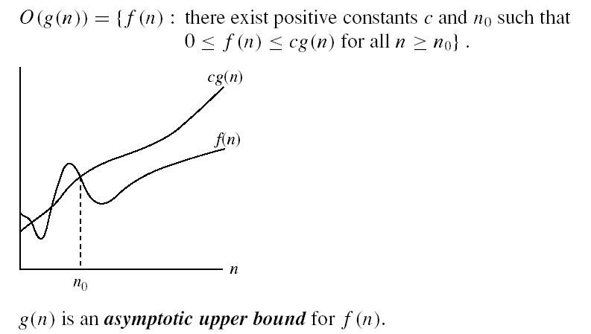
Asymptotic notations
O-notation

Slide 17
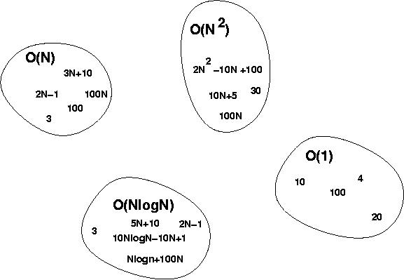
Big-O Visualization
O(g(n)) is the set of functions with smaller or same order of growth as g(n)

Slide 18
Examples
  2n² = O(n³):
  n² = O(n²):
  1000n²+1000n = O(n²):
  n = O(n²):
2n² ≤ cn³ ⇒ 2 ≤ cn ⇒ c = 1 and n₀= 2
n² ≤ cn² ⇒ c ≥ 1 ⇒ c = 1 and n₀= 1
1000n²+1000n ≤ 1000n²+ n² =1001n²⇒ c=1001 and n₀ = 1000
n ≤ cn² ⇒ cn ≥ 1 ⇒ c = 1 and n₀= 1

Slide 19
More Examples
Show that 30n+8 is O(n).
  Show that there exist some c and n₀ such that 30n+8 ≤ cn, ∀n>n₀ .
    Let c=31, n₀=8. Assume n>n₀=8. Then
    cn = 31n = 30n + n > 30n+8, so 30n+8 < cn.

Slide 20
Big-O example, graphically
Note 30n+8 isn’t
less than n
anywhere (n>0).
It isn’t even
less than 31n
everywhere.
But it is less than
31n everywhere to
the right of n=8.
cn =
31n
30n+8
30n+8
∈O(n)
Value of function →
n
n>n₀=8 →
Increasing n →

Slide 21
No Uniqueness
There is no unique set of values for n₀ and c in proving the asymptotic bounds
Prove that 100n + 5 = O(n²)
  100n + 5 ≤ 100n + n = 101n ≤ 101n²
  for all n ≥ 5
  n₀ = 5 and c = 101 is a solution
  100n + 5 ≤ 100n + 5n = 105n ≤ 105n²
  for all n ≥ 1
  n₀ = 1 and c = 105 is also a solution
  Must find SOME constants c and n₀ that satisfy the asymptotic notation relation

